Slide 1
Ensemble Methods for NBA Salary Prediction
UW SPA DRP Spring 2022
Pranav Natarajan
Notes:
Good Afternoon! My name is Pranav Natarajan, and I will be presenting about Ensemble Methods for NBA salary prediction.

Slide 2
PROBLEM STATEMENT
Predicting the Salary of an NBA player given their intrinsic information and in game statistics through the season.
Notes:
So, I have always been quite interested in sports (especially soccer) since I was 6.
As I watched more and more of it, I became well engrossed in the player acquisition-side of things.
I noted many high-salaried players perform poorly, and conversely, relatively cheap acquisitions exceed expectations and earn their true value upon those performances.
This volatility in performances led me to think about incorrect value estimation of players by teams, and how teams’ scouting, recruitment and finances could benefit from sound player value estimation.
In a basketball context, I wished to explore the best model that could provide an estimation of a floor value of NBA yearly salary given a player’s biodata and in game statistics. Another thing to note is the scaling for NBA rookie salaries, where the first round picks can sign for as low as 80% and as high as 120% of the stipulated rookie contract value, while second rounders are free to negotiate any size of contract. Both rookies can have their contracts optionally extended. These estimates can help teams rationalise the value loss (or gain) they incur by having the player on their roster.
Thus, this project serves to present the supervised learning problem of predicting the yearly NBA player salary given those player attributes.

Slide 3
DATA QUERYING & PROGRAMMING
R v(4.1.2)
nbastatR (maintained by Abe Resler)
BasketballReference
Notes:
Programming was done on RStudio running R version 4.1.2.
Data for the player bios and in-game statistics, were provided from the nbaStatR package on R, maintained by Abe Resler, which queried both NBA.com and Basketball Reference.
Moreover, Yearly Salary Cap Data was obtained directly from the Basketball Reference Website.

Slide 4
R PACKAGES USED
tidyr v(1.2.0) & dplyr v(1.0.8)
caret v(6.0-92)
ranger v(0.13.1)
Boruta v(7.0.0)
xgboost v(1.6.0.1)
glmnet v(4.1-4)
Notes:
Moving on to the specific R packages used,
tidyr and dplyr were used for data manipulation
caret was used for running cross validation, hyperparameter tuning, & model evaluation
ranger, xgboost, and glmnet were used to implement randomForests, xgboost ensembles, and the elastic net respectively
Finally, the Boruta package was used to implement Boruta Feature Selection

Slide 5
DATA PREPROCESSING
Rookies from 1985-86 to 2020-21
Salary normalised by yearly salary cap
Pertinent Features:-
Usage %
Player Efficiency Rating
VORP
Win Shares
80-20 stratified train-test split
5 fold CV for hyperparameter tuning
Age
Position
Team(s)
Count of Games
Notes:
The Data included player statistics from 1985-86 through 2020-21 seasons, including those who were drafted into the NBA as well.
The draft was used to subset players for this dataset owing to the reason that all players in the NBA come into the NBA through the draft - including international players and players from foreign basketball leagues.
The start season was chosen as 1985-86 as that was the year that the NCAA first universally implemented a 3 point line in basketball. this subsetting helps maintain rule uniformity regarding scoring in the NBA and NCAA, where our draft players are predominantly from.
Some of the 23 features include player age at the start of the season, teams played for, and a count of games–total, started and not started through the season, and some transformed metrics such as the box plus-minus. Some of the more pertinent advanced metrics include Percentages of Usage, Value over replacement player, Player Efficiency Rating, and the ratio of Win Shares.
The salaries are normalised by yearly salary cap to negate the effects of inflation and other economic factors affecting salary fluctuations in the NBA. Thus, the supervised learning problem will predict the normalised salary values for the given set of features for a player
An 80-20 train test split was performed on the 9628 observations. All features except Team and position were standard scaled using mean and standard deviation on the training set. the categorical features were one hot encoded.
for model tuning and fitting, I use 5 fold cross validation.
Before I get onto the models themselves, let me provide a bit of information about Ensemble models and the Boruta Feature Selection Algorithm.

Slide 6
WHAT IS AN ENSEMBLE MODEL?
A Model that “aggregates” estimates from a (large) number of other models (weak learners) to provide a final estimate for the supervised learning problem.
Training sets are bagged or pasted
Notes:
Now, what exactly IS an ensemble model?
It is a model that aggregates on the predictions of a large number of other models to provide a final estimate for a supervised learning problem.
The training sets for each of these weak learners are either procured by bootstrapping training samples (with replacement) called bagging, or by subsampling training samples without replacement, called pasting.
Some examples of Ensemble Models for Regression are Random Forests and Gradient Boosted Regressors.

Slide 7
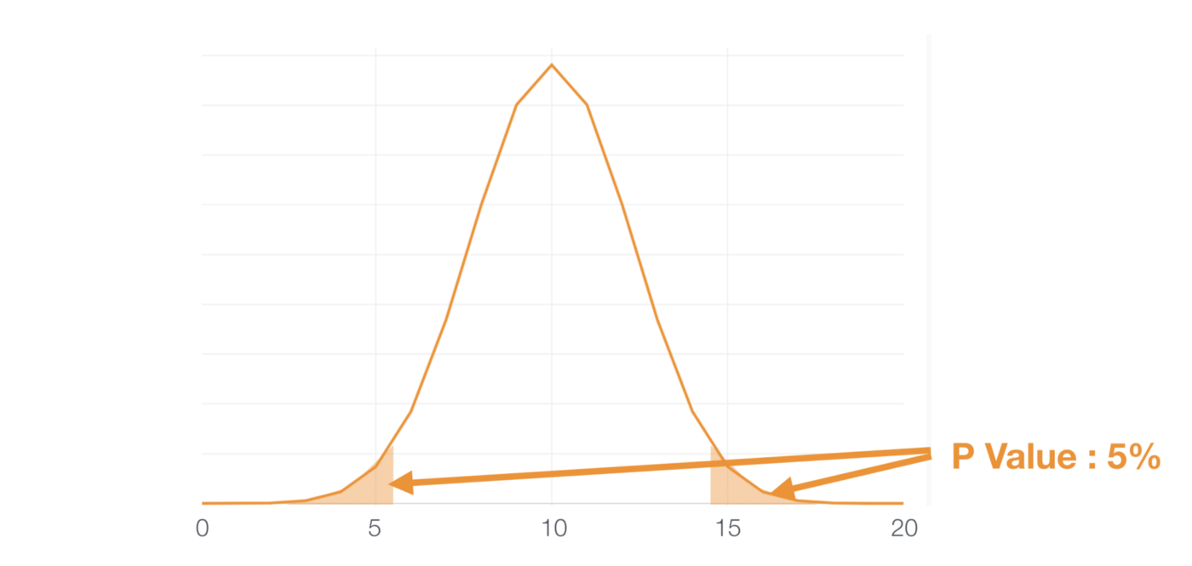
BORUTA ALGORITHM
Central Idea:-
Feature is useful iff it performs better than the best randomised feature
¹
¹ (Nishida, Finding variable importance with Random Forest & Boruta, 2019)
Notes:
The Boruta algorithm is an all relevant feature selection algorithm for models with a variable importance metric.
It creates a feature set including both the original features, and their randomised shuffles, called shadow features. Then, an ensemble model is run on these features to predict the labels, and variable importance is ascertained.
If a feature has higher variable importance than the best performing shadow feature, then it is considered to be a ‘hit’ for that run.
Multiple runs are performed, and noting that the maximum level of uncertainty about a feature is 0.5, we have the normal approximation to the binomial distribution helping us ascertain the hits of variables to select.
Given a significance level (as in the picture, an example significance level of 5%), A relevant hypothesis test helps us determine features that are selected, rejected, and tentative.
For this project, 250 runs were performed with a significance level of 1%.
Now, I needed a baseline model to compare by ensemble methods’ out of sample performance.
picture credit:- https://blog.exploratory.io/finding-variable-importance-with-random-forest-boruta-28badd116197

Slide 8
BASELINE MODEL
Elastic Net
Optimal Hyperparameters
𝛼 = 0.1
𝜆 = 0.0003342206
Notes:
I chose an elastic net, which performs a combination of L1 and L2 norm regression on the feature weights in the loss function, with optimal hypermarameters found using 5 fold Randomised search cross validation.

Slide 9
RESULTS
MODEL | OUT OF SAMPLE RMSE | ERROR VALUATION IN 2021 SALARY ($)
Random Forest | 0.05375 | 6,041,710
XGBoost-Linear | 0.05485 | 6,165,897
Stochastic XGBoost - Tree | 0.05486 | 6,167,435
XGBoost - Tree | 0.05491 | 6,172,589
Elastic Net | 0.05945 | 6,683,473
Notes:
I used 4 ensemble methods, namely a random forest, a gradient boosted linear and tree models, and a stochastic gradient boosted tree model.
We note that the Random Forest performed the best out of sample, followed by fellow ensemble methods of a linear Gradient Boosted model, and a Stochastic Gradient Boosted Tree.
In interest of time, we will focus on the Random Forest, and the Stochastic Gradient Boosted Tree model.

Slide 10
RANDOM FOREST
Prediction from Tree 1
Prediction from Tree 2
estimate = mean (Prediction)
Feature Observation
Prediction from Tree 3
.
.
.
Prediction from Tree n
Notes:
What is a Random Forest Model?
The Random Forest Model trains its weak lerners, that are decision trees, using bagged training datasets of equal number of observations as the original training set.
To get predictions It then averages all the predictions from each tree given the data to provide the final estimate.
The randomness induced by the bagging process in creating the training sets, and the increased number of trees will controls overfitting well in most cases.

Slide 11
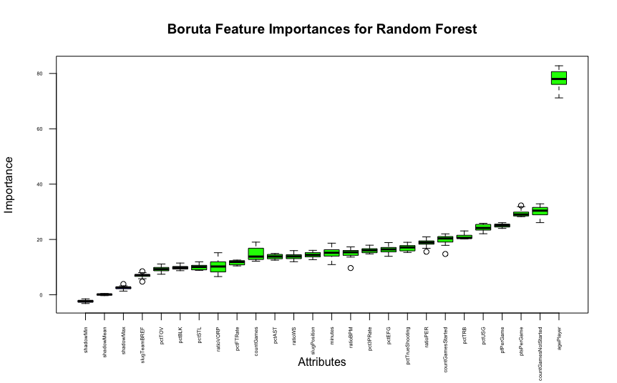
RANDOM FOREST FEATURE SELECTION
Notes:
I used 250 runs of the boruta algorithm to select features for the random forest model. From the algorithm, we note that all variables are selected, and that the usage percentage, personal fouls and points per game, count of games not started, and the age of the player are particularly important.

Slide 12
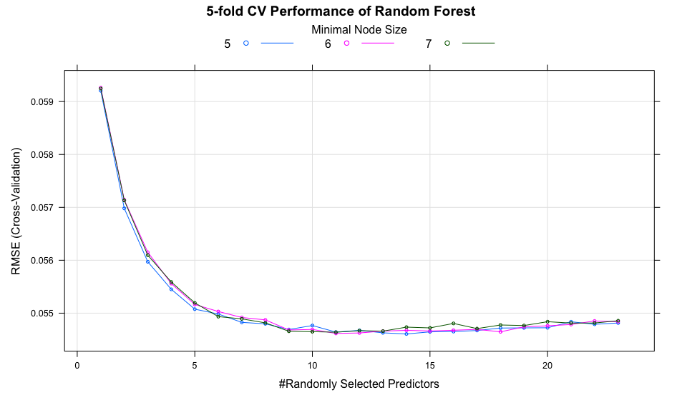
RANDOM FOREST HYPERPARAMETER TUNING
Notes:
I then performed hyperparameter tuning using 5 fold cross validation.
I tuned the hyperparameters corresponding to
the random number of features chosen to determine the split at each nonterminal node of each weak learner,
The number of observations in terminal nodes, called the minimum node size, which implicitly determined the tree depth. (nodesize low implies larger depth and vv)
The function to minimise at each split of each weak learner, which is the weighted variance by default for Random Forest regression, was held constant through the tuning process.
The optimal hyperparameters were the minimal node size of 5, and 14 random features to split at each nonterminal node.
There exists scope for further hyperparameter tuning (especially increasing the number of weak learners in the ensemble from the default 500).

Slide 13
GRADIENT BOOSTING & XGBOOST
Train & test base learner Model on Training set as per. Procure Residuals
Train and Test on Features as training set and Labels as residuals from Model 2. Procure Residuals
Model 1
Model 3
Final Model = sum of all ‘n’ models
Training Set
Model 2
Model ‘n’
Train and Test on Features as training set and Labels as residuals from Model 1. Procure Residuals
Train and Test on Features as training set and Labels as residuals from Model (n-1).
Notes:
Now, what is a Gradient Boosted Model?
The Gradient Boosted model is an additive ensemble model, which aims to reduce bias by training subsequent weak learners on the residuals of its previous models, thereby helping .
The models can either be decision trees, or linear regularised regression models.
This iterative addition of models improve its prediction accuracy, but is susceptible to overfitting, which can be controlled by introducing regularisation, specifically learning rate hyperparameters, regularisation of coefficients, and random subsampling of training samples without replacement, called Stochastic Gradient boosting.
XGBoost is a method to improve the speed and efficacy of gradient boosting methods, and that is what we will use to implement boosting models in this project.
Link for explaining intuition behind gradient boosting:- https://explained.ai/gradient-boosting/L2-loss.html#sec:2.3
Link explaining Stochastic Gradient Boosting and gradient Boosting in R:-
http://uc-r.github.io/gbm_regression#idea
Link for XGBoost Documentation:-
https://arxiv.org/abs/1603.02754

Slide 14
STOCHASTIC GRADIENT DESCENT
Random Subsampling (without replacement) of Training set
Evades plateaus and local minima in cost function
Faster execution with minimal tradeoff
Notes:
Stochastic Gradient Boosting involves the random subsampling of the training set, without replacement, to train weak learners in the ensemble.
Not all loss functions are convex, and thus might have local minima or plateau regions. Stochastic Gradient Descent evades these regions to hopefully arrive close to a global minimum. However, due to it’s random nature, true convergence to the global minimum cannot be guaranteed, but in most cases, the solution is more than workable.
The better performance of the Stochastic gradient boosted tree model could also signify the reduction of overfitting through random subsampling.

Slide 15
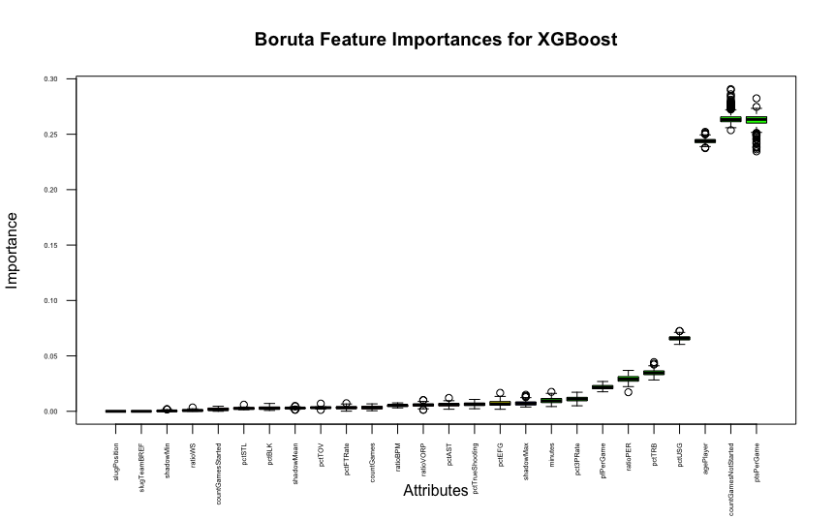
XGBOOST FEATURE SELECTION
Notes:
I used 250 runs of the boruta algorithm to select features for the xgboost model.
Not all variables were selected this time. There were 13 rejected variables, and one tentative variable of the 23. I decided to not use them.
From the selected 9, we again note that the usage percentage, points per game, count of games not started, and the age of the player remain particularly important in salary prediction.

Slide 16
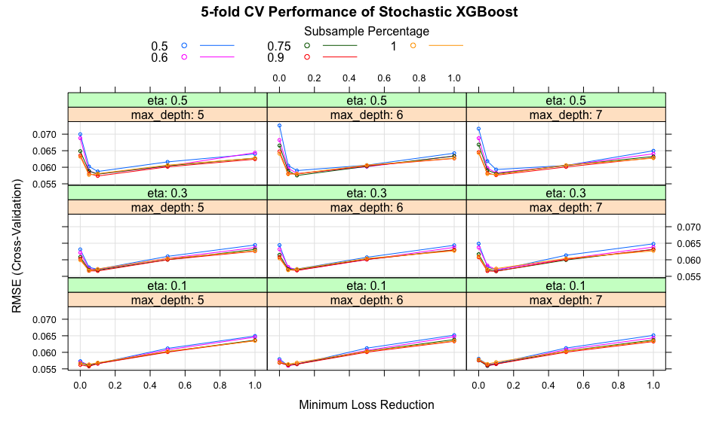
STOCHASTIC XGBOOST TREE HYPERPARAMETER TUNING
Notes:
We note from the hyperparameter tuning, that the best performance was when the learning rate was in the smallest increment of 0.1, with a training subsample of 90% being used to create a decision tree of 5 levels.
For further hyperparameter tuning, we can focus on a neighbourhood for the learning rate from 0.05 to 0.1, and similar focused neighbourhoods of subsampling and tree depth to hopefully evince better results.

Slide 17
CONCLUSIONS & SCOPE FOR FURTHER RESEARCH
MODEL | OUT OF SAMPLE RMSE | ERROR VALUATION IN 2021 SALARY ($)
Random Forest | 0.05375 | 6,041,710
XGBoost-Linear | 0.05485 | 6,165,897
Stochastic XGBoost - Tree | 0.05486 | 6,167,435
XGBoost - Tree | 0.05491 | 6,172,589
Elastic Net | 0.05945 | 6,683,473
Ensemble methods better for the supervised learning problem
Best Model:- Random Forest
Further hyperparameter tuning
2021 Salary Cap = $ 109,140,000
Notes:
In conclusion, we see that all the ensemble methods–especially the random forest–performed better out of sample than the tuned elastic net.
The Stochastic XGBoosted Tree also performed comparably, with much less computational cost.
I did not perform as extensive a tuning of hyperparameters for the Random Forest and the Stochastic XGBoosted Tree.
There is scope to adopt a more iterative process to hyperparamter tuning to obtain more focused neighbourhoods of hyperparameters.
Increasing the number of weak learners reduces the chances of overfitting and increasing their number is something worth exploring for the random forest, and performing regularisation in tandem with increasing the number of weak learners in a gradient boosted model is worth exploring as well.
In most cases, these models need to be trained at the end of each season, that is, once every year. It then makes sense to focus efforts on tuning the best performing random forest to obtain the best salary estimates.

Slide 18
Thank You
Notes:
And that brings me to the end of my presentation. Thank you for your time!

Slide 19
REFERENCES
Adams, L. (2021, August 4). Rookie scale salaries for 2021 NBA first-round picks. Retrieved June 8, 2022, from https://www.hoopsrumors.com/2021/08/rookie-scale-salaries-for-2021-nba-first-round-picks.html
Boehmke, B. (n.d.). Gradient Boosting Machines. Gradient Boosting Machines · UC Business Analytics R Programming Guide. Retrieved June 8, 2022, from http://uc-r.github.io/gbm_regression#idea
Chen, T., & Guestrin, C. (2016, June 10). XGBoost: A scalable tree boosting system. arXiv.org. Retrieved June 8, 2022, from https://arxiv.org/abs/1603.02754
Friedman, J., Hastie, T., & Tibshirani, R. (2010). Regularization Paths for Generalized Linear Models via Coordinate Descent. . URL . Retrieved from https://www.jstatsoft.org/v33/i01/

Slide 20
REFERENCES
Kuhn, M. (2022). caret: Classification and Regression Training. R package version 6.0-92. Retrieved from https://CRAN.R-project.org/package=caret
Kursa, M. B., & Rudnicki, W. R. (2010). Feature Selection with the Boruta Package. Retrieved from http://www.jstatsoft.org/v36/i11/
Nishida, K. (2019, September 27). Finding variable importance with Random Forest & Boruta. Medium. Retrieved June 8, 2022, from https://blog.exploratory.io/finding-variable-importance-with-random-forest-boruta-28badd116197
Parr, T., & Howard, J. (n.d.). The intuition behind gradient boosting. Gradient Boosting: Distance to Target. Retrieved June 8, 2022, from https://explained.ai/gradient-boosting/L2-loss.html#sec:2.3
Resler, A. (2022, May 6). Abresler/NBASTATR: R's interface to NBA data version 0.1.151 from github. Retrieved June 8, 2022, from https://rdrr.io/github/abresler/nbastatR/

Slide 21
REFERENCES
Sports Reference LLC. (n.d.). Basketball-Reference.com - Basketball Statistics and History. Retrieved June 8, 2022, from https://www.basketball-reference.com/
Steinberg, L. (2018, June 28). The NBA draft process for dummies. Retrieved June 8, 2022, from https://www.forbes.com/sites/leighsteinberg/2018/06/21/behind-the-scenes-the-nba-draft-process-for-dummies/?sh=38a3134f6095
Wickham, H., & Girlish, M. (2022). tidyr: Tidy Messy Data. R package version 1.2.0. . Retrieved from https://CRAN.R-project.org/package=tidyr
Wickham, H., François, R., Henry, L., & Muller, K. (2022). dplyr: A Grammar of Data Manipulation. R package version 1.0.8. . Retrieved from https://CRAN.R-project.org/package=dplyr

Slide 22
REFERENCES
Wood, R. (2011, June 15). The History of the 3-pointer. The history of the 3-pointer. Retrieved June 8, 2022, from https://www.usab.com/youth/news/2011/06/the-history-of-the-3-pointer.aspx
Wright, M. N., & Ziegler, A. (2017). ranger: A Fast Implementation of Random Forests for High Dimensional Data in C++ and R. Journal of Statistical Software 77(1), 1-17. https://doi.org/10.18637/jss.v077.i01
Mazzanti, S. (2021, February 12). Boruta explained the way I wish someone explained it to me. Medium. Retrieved June 8, 2022, from https://towardsdatascience.com/boruta-explained-the-way-i-wish-someone-explained-it-to-me-4489d70e154a

